Slide 1
Challenge 1 Wireless Sensor Networks for Temperature Monitoring
Group 3
Aoshuang wang, lan yao, yixuan huang, lan luo

Slide 2
 | Lan Yao | Aoshuang Wang | Yixuan Huang | Lan Luo
Challenge 1 | Presenter
Challenge 2
Challenge 3
Challenge 4
Challenge 5
Challenge 6
Challenge 7
Challenge 8

Slide 3
 | Lan Yao | Aoshuang Wang | Yixuan Huang | Lan Luo
1 | Program Writing Configure Component Parameter | Program Writing Configure Component Parameter | Hardware Connection Configure Component Parameter | Hardware Connection Configure Component Parameter

Slide 4
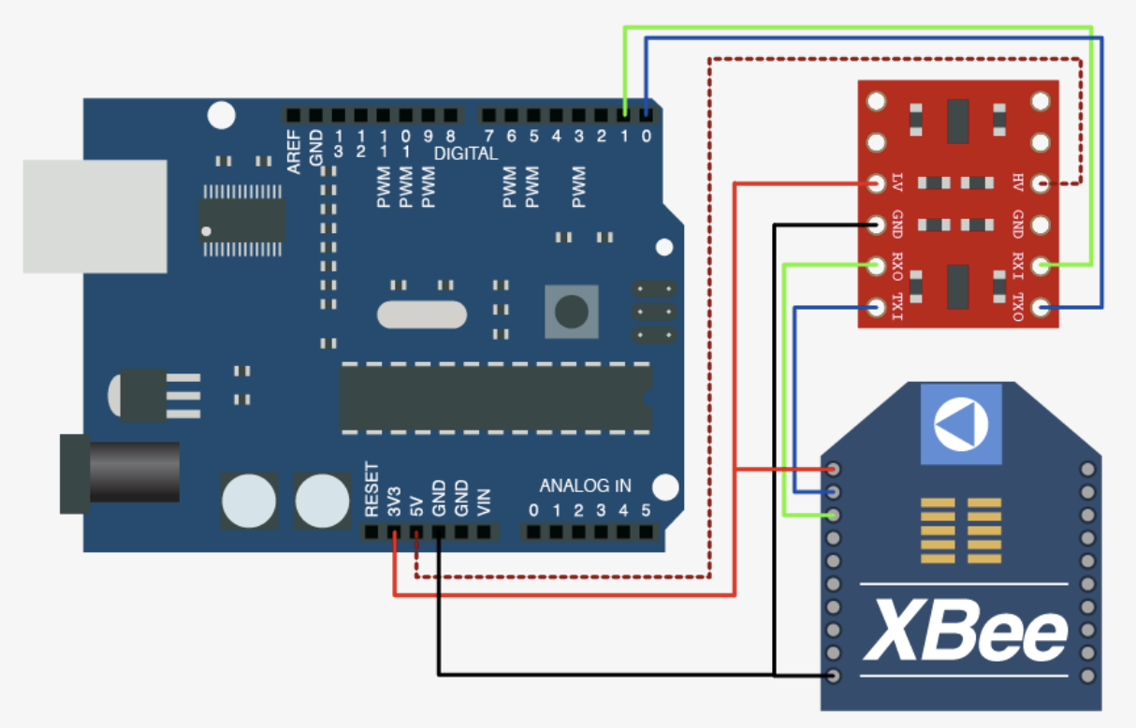
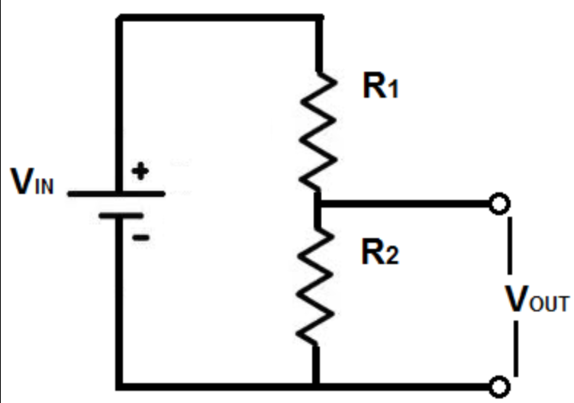
Components Used

Slide 5
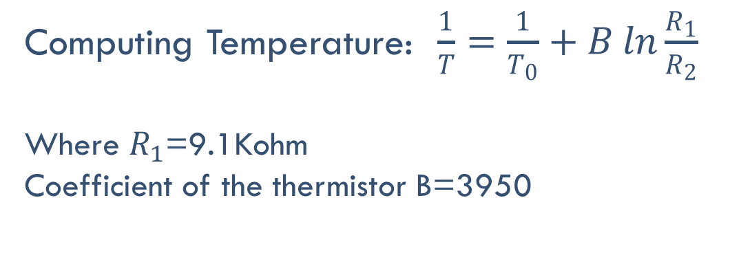
Thermistor Resistance : $\frac{R_{1}}{R_{2}}=\frac{1023}{V_{out}}−1$
Computing Temperature: $\frac{1}{T}=\frac{1}{T_{0}}+B ln\frac{R_{1}}{R_{2}}$
Where $R_{1}$=9.1Kohm
Coefficient of the thermistor B=3950

Slide 6
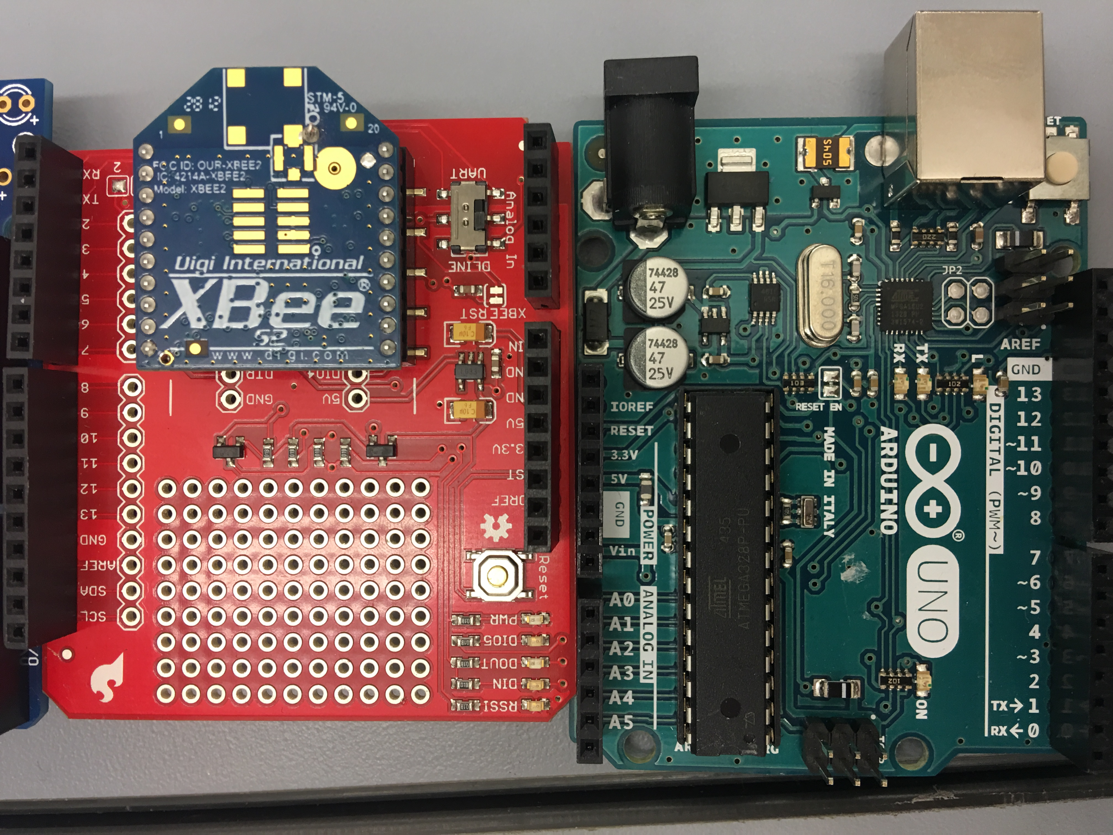
Photos of Developed System

Slide 7
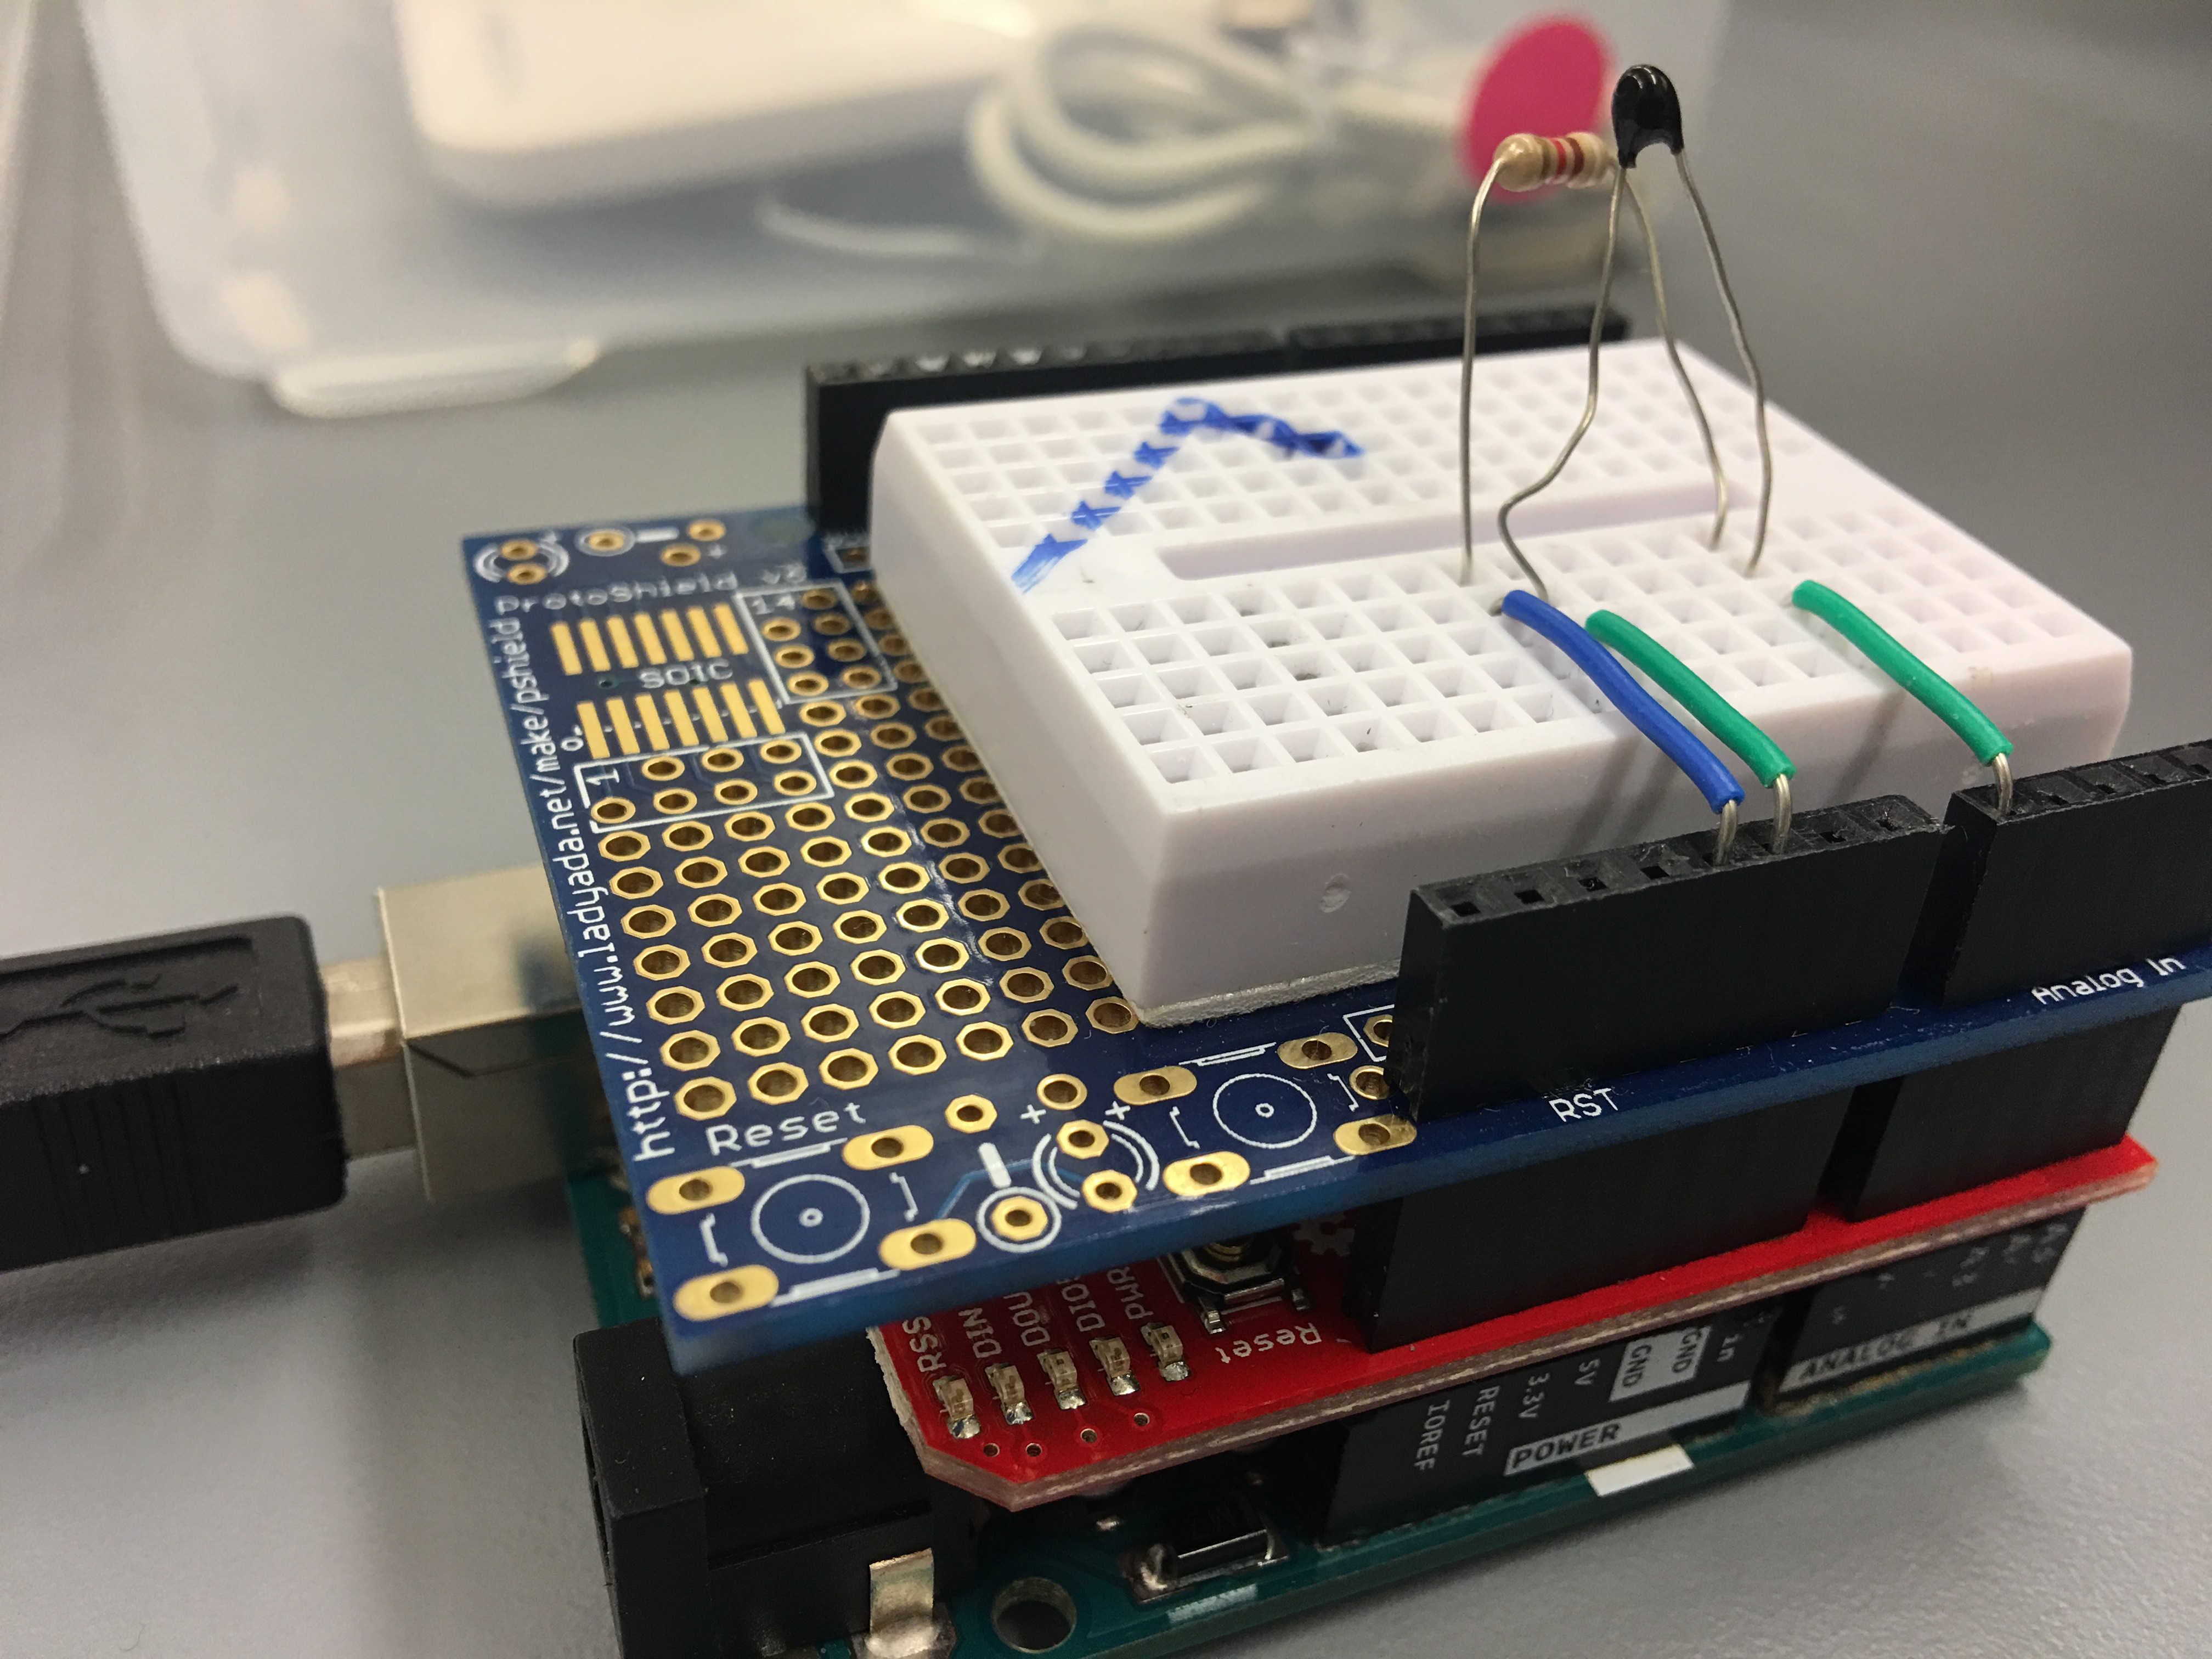
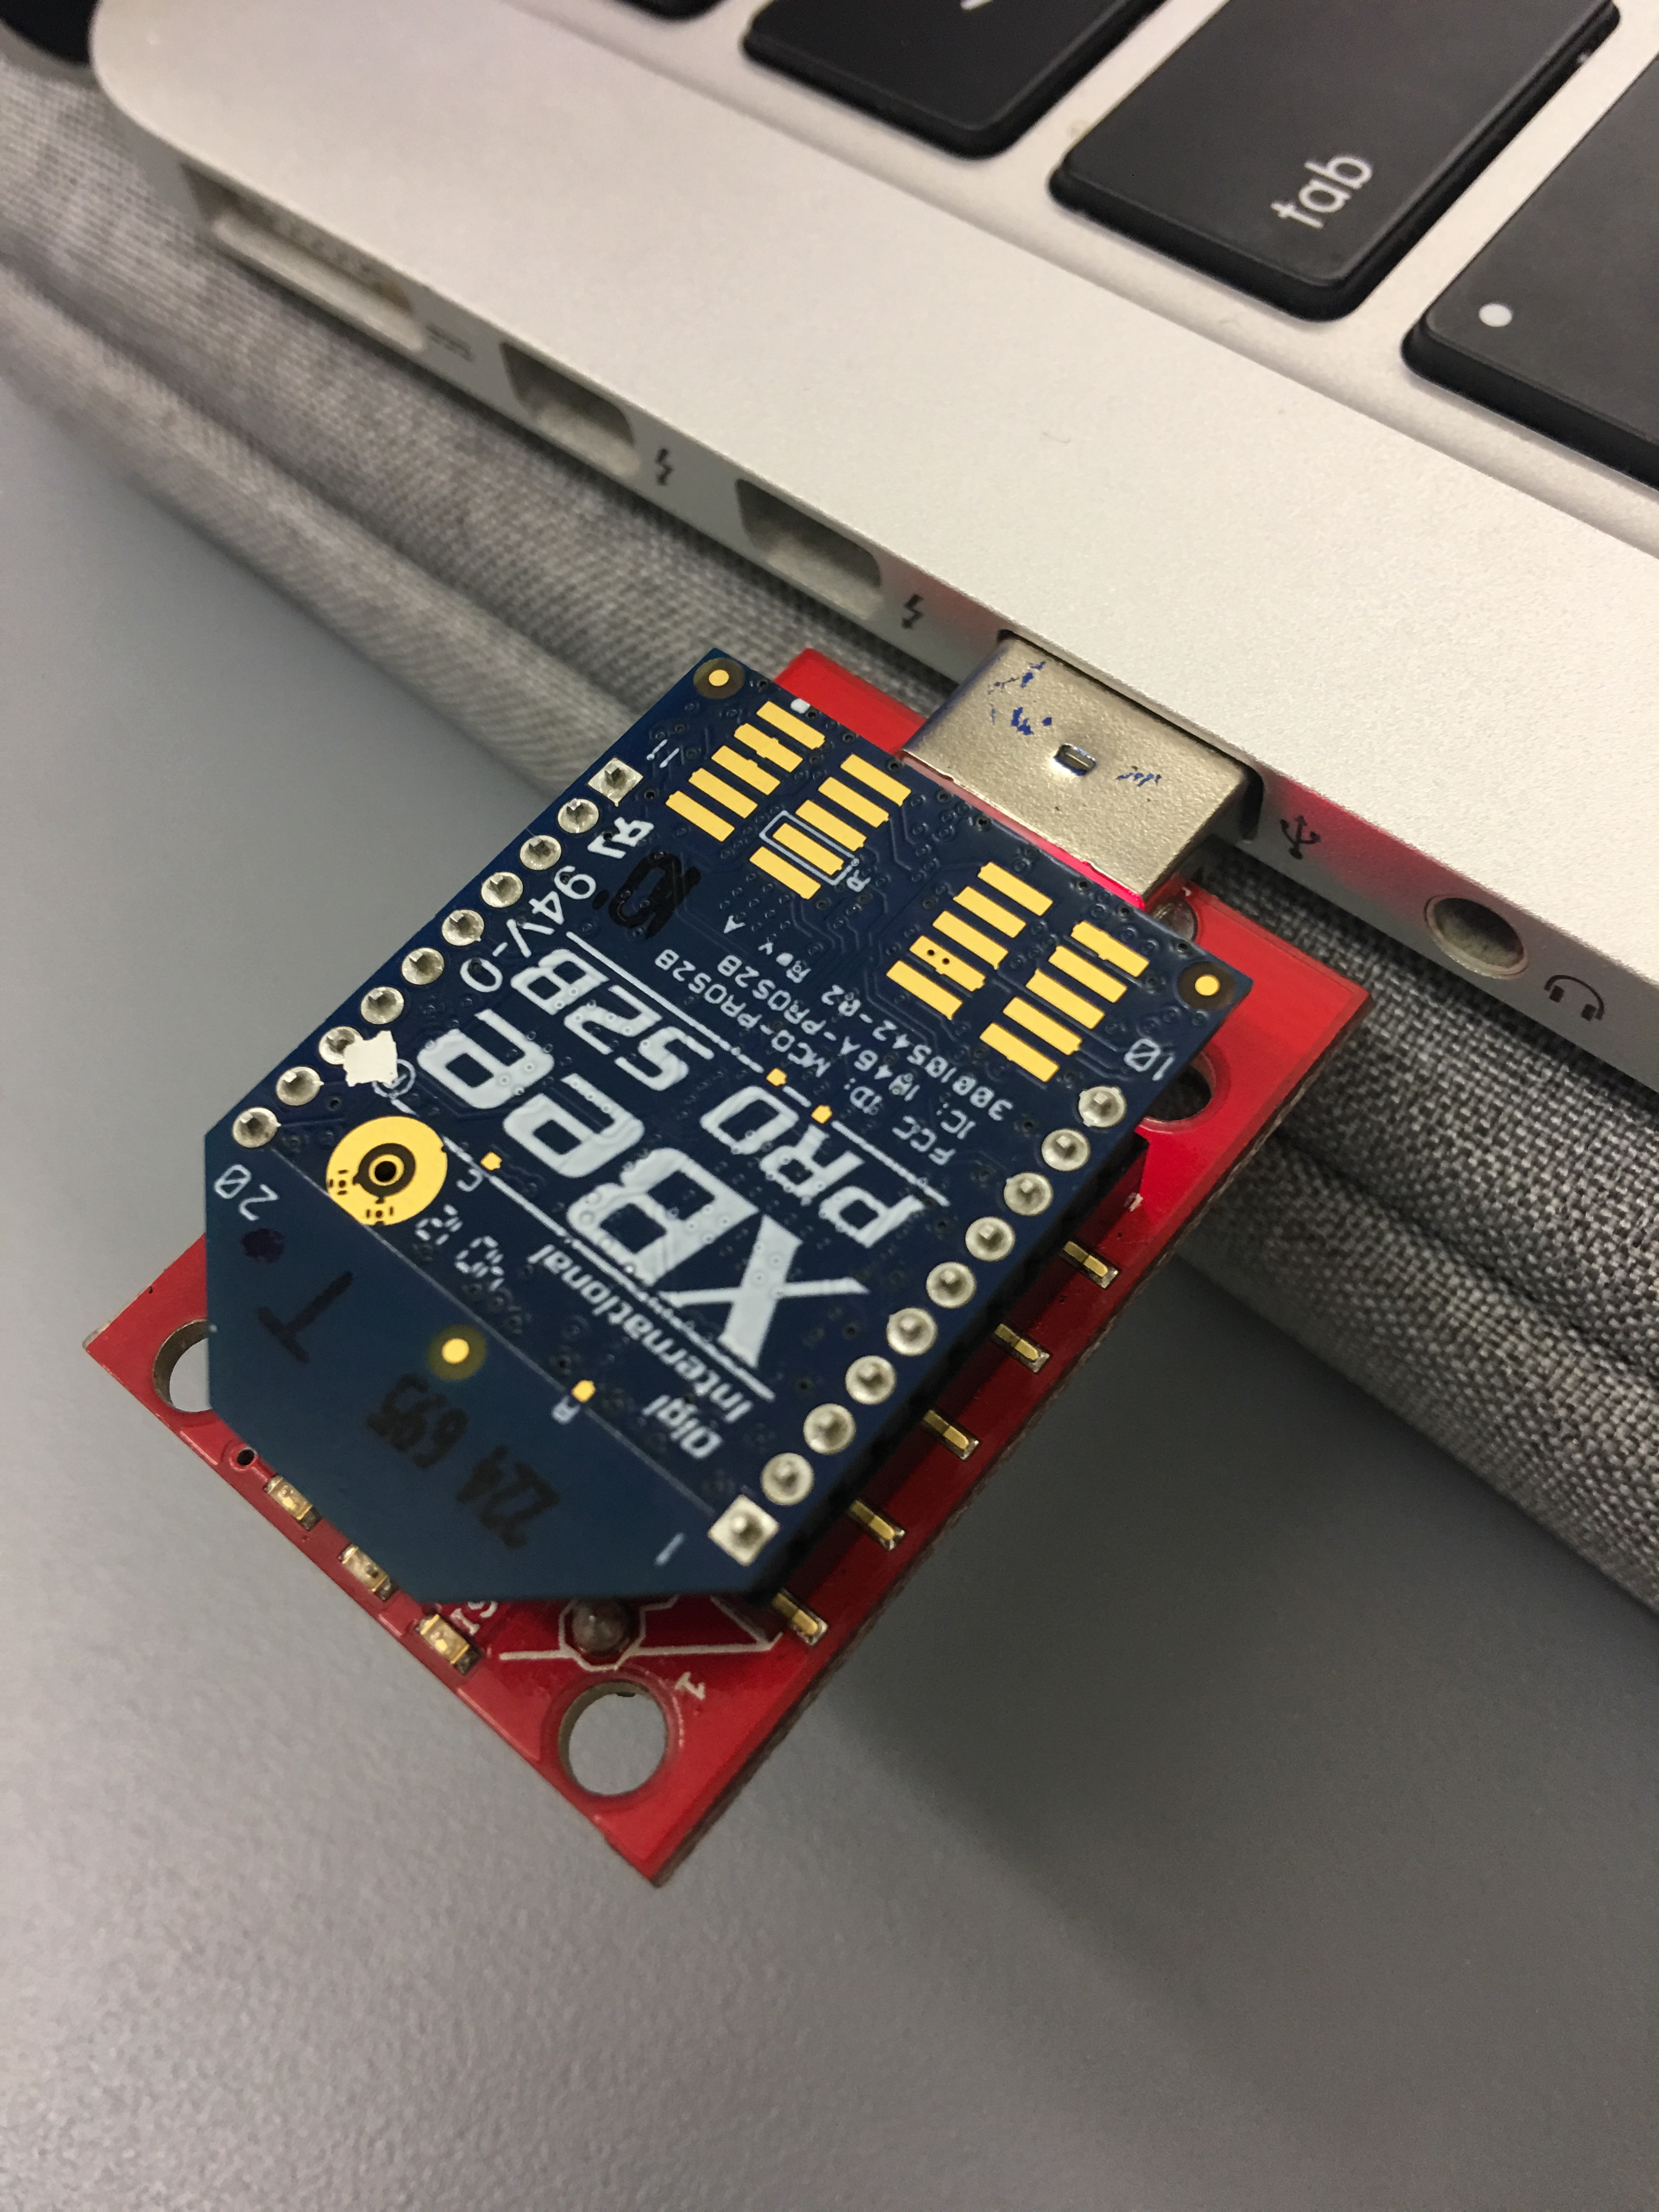
Photos of Developed System
Coordinator(Receive)
Router(Send)

Slide 8
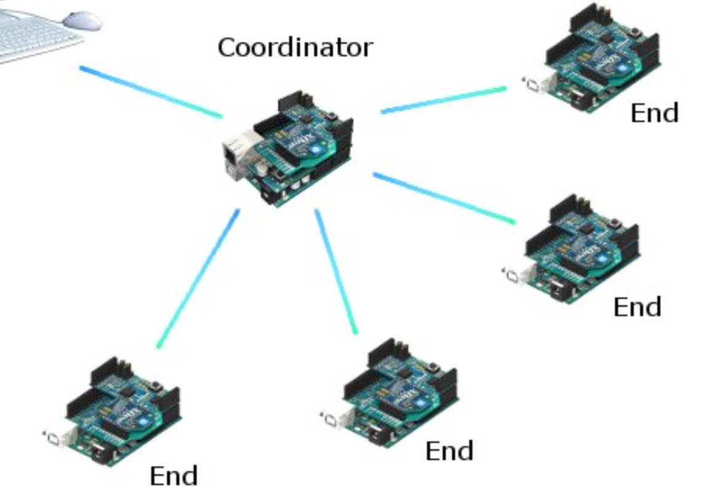
Photos of Developed System

Slide 9
Challenges Encountered and Resolved
Hardware Issues
Accuracy Improved

